Slide 1
Magnetosomes: Nanoscale Magnetic Iron Minerals in Bacteria

Slide 2
Magnetotactic Bacteria
Magnetotactic bacteria found in chemically stratified water columns or sediments where they occur predominantly in or below the microaerobic redox transition zone, between the aerobic zone of upper waters or sediments and the anaerobic regions of the habitat.
Magnetotaxis is the orientation and navigation along magnetic field lines by motile, aquatic, bacteria
They are a diverse group of microorganisms with respect to morphology, physiology, and phylogeny
Common morphotypes include coccoid to ovoid cells, rods, vibrios, and spirilla of various dimensions, and multicellular forms.
All Magnetotactic bacteria are motile by means of flagella
Possess a cell-wall structure characteristic of Gram-negative bacteria.
The arrangement of flagella varies between species/strains: cells with polar or bipolar single flagella and others with bundles of flagella have been observed

Slide 3
Magnetotactic Bacteria
Magnetotactic bacteria are difficult to isolate and grow in pure culture.
Most cultured strains belong to the genus Magnetospirillum
Other species of cultured magnetotactic bacteria include a number of incompletely characterized organisms:
marine vibrios, strains MV-1 and MV-2
marine coccus, strain MC-1
marine spirillum, strain MV-4
Desulfovibrio magneticus, strain RS-1 (anaerobic, sulfate-reducing, rod-shaped bacterium)
These cultured organisms, except strain RS-1, are obligate or facultative microaerophile
and all are chemo organo heterotrophic, although the marine strains also grow chemo litho autotrophically.

Slide 4
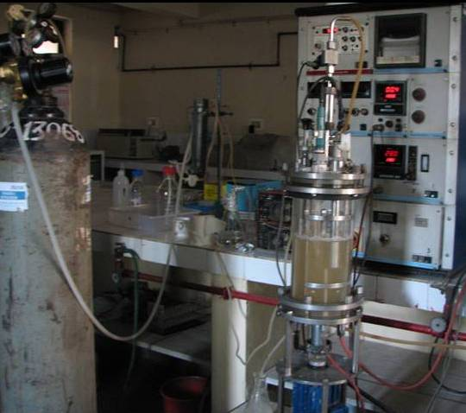
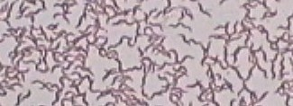
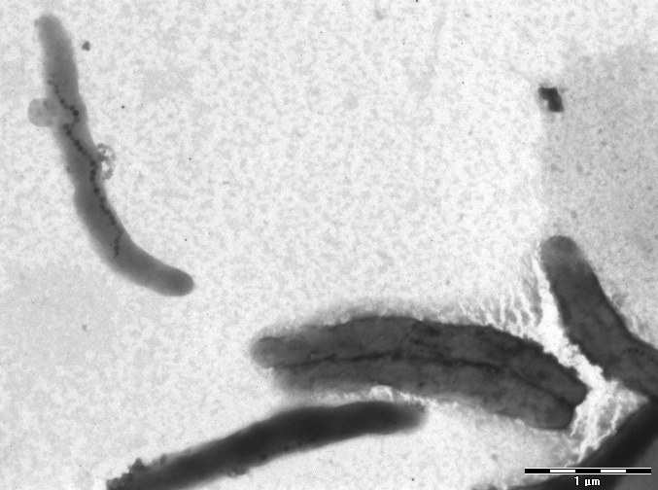
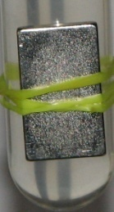
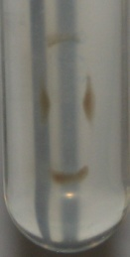
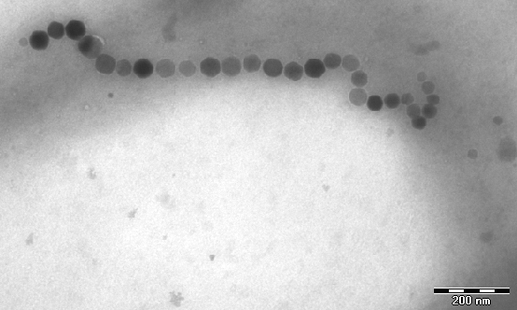
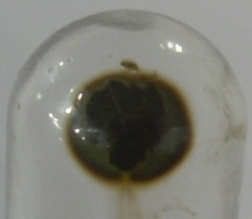

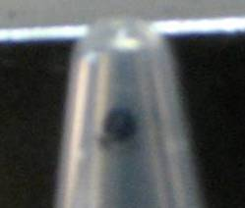
b
5µm
d
c
1µm
e
200nm
f
g
h
a

Slide 5
Magnetosomes
All magnetotactic bacteria contain magnetosomes
Magnetosomes are intracellular structures comprising magnetic iron mineral crystals enveloped by a membrane vesicle.
The magnetosome membrane (MM) is presumably a structural entity that anchors the crystals at particular locations in the cell,
MM is locus of biological control over the nucleation and growth of the magnetosome crystals.
The MM in genus Magnetospirillum is a lipid bilayer consisting of neutral lipids, free fatty acids, glycolipids, sulfolipids, and phospholipids
It is often located adjacent to the cytoplasmic membrane, although there is no clear microscopic evidence for direct connections between the two.
Empty and partially-filled vesicles have been reported in iron-starved cells, suggesting that magnetosome vesicles are formed prior to the deposition of the mineral crystals

Slide 6
Magnetosomes
The magnetosome magnetic mineral phase consists of magnetite, Fe₃O₄, or greigite, Fe₃S₄.
Each magnetotactic species or strain exclusively produces either magnetite or greigite magnetosomes, except for one marine organism that produces magnetosomes of both kinds
The magnetosome crystals are 35 to 120 nm in length, although crystals with lengths of ~ 200 nm are known
In most magnetotactic bacteria, the magnetosomes are organized in straight chains of various lengths parallel to the long axis of the cell
Dispersed aggregates or clusters of magnetosomes occur in some magnetotactic bacteria, usually at one side of the cell, which often corresponds to the site of flagellar insertion
High degree of control over magnetosome formation and arrangement is evident through:
The narrow size range of magnetosome crystals
Consistent morphologies of the magnetosome crystals in each species or strain
Consistent crystallographic orientation of the magnetosomes in chains

Slide 8
Cellular Magnetic Dipole and Magnetotaxis
The size-range and linear arrangement of magnetosomes are highly significant for the magnetic properties of the cell
The magnetosome crystals are within the permanent single-magnetic-domain (SD) size-range for both magnetite and greigite, and are thus uniformly magnetized with maximum magnetic dipole moment per unit volume
Magnetic crystals larger than SD size are nonuniformly magnetized because of formation of magnetic domains or vortex configurations, further reducing their magnetic dipole moments.
On the other hand, very small SD particles are superparamagnetic (SPM).
Although SPM particles are uniformly magnetized, their magnetic dipole moments are not constant because of spontaneous, thermally induced, reversals which produce a time-averaged moment of zero.
Therefore, magnetotactic bacteria produce magnetosomes with the optimum particle size for the maximum, permanent, magnetic dipole moment per magnetosome.

Slide 9
Cellular Magnetic Dipole and Magnetotaxis
The arrangement of the SD magnetosomes in chains maximizes the dipole moment of cell
The reason being, magnetic interactions between the magnetosomes in a chain cause each magnetosome moment to orient spontaneously and in parallel with others along the chain axis, minimizing the magnetostatic energy.
Thus the total dipole moment of the chain, M, is the algebraic sum of the moments of the individual magnetosomes in the chain
However, this is true only because magnetosomes are physically constrained by magnetosome membranes in the chain configuration.
If free to float in the cytoplasm, magnetosomes would likely clump, resulting in a much smaller net dipole moment than in the chain.
For organisms such as Magnetospirillum magnetotacticum, the remanent moment is the maximum possible moment of the chain

Slide 10
Cellular Magnetic Dipole and Magnetotaxis
Magnetotaxis results from passive orientation of a swimming magnetotactic bacterium along local magnetic field by torque exerted by the field B (e. g., the geomagnetic field) on cellular dipole moment M
A chain of 10–20 magnetosomes, each of dimension 50 nm, would be sufficient for the orientation of a magnetotactic bacterium in the geomagnetic field at ambient temperature.
Since the chain of particles is fixed within the cell, the entire cell is oriented by torque exerted on magnetic dipole by the magnetic field.
If the magnetic field is decreased, the time-averaged orientation of the cell along the field is decreased and the migration rate of the cell along the magnetic field direction is decreased, even though the forward-swimming speed of the cell is unchanged.
Thus, magnetotactic bacteria behave like self-propelled magnetic dipoles.

Slide 11
Cellular Magnetic Dipole and Magnetotaxis
The potential energy (E) of the cellular magnetic dipole moment in the magnetic field is given by:
(1)
where Θ is the angle between M and B.
Thermal energy at ambient temperatures will tend to cause misalignment of the swimming bacterium.
In thermal equilibrium at temperature T, the probability of the moment having energy E_{Θ} is proportional to the Boltzmann factor exp(–E_{Θ} /kT), where k is Boltzmann’s constant.
The thermally averaged projection of the dipole moment on the magnetic field <cosΘ> can be determined from the Langevin theory of paramagnetism and is given by Langevin function L(α)
( (2)
where α = MB/kT. L(α) = 0 for α = 0 and asymptotically approaches 1 as α approaches ∞.
In particular, L = 0.9 when α = 10.

Slide 12
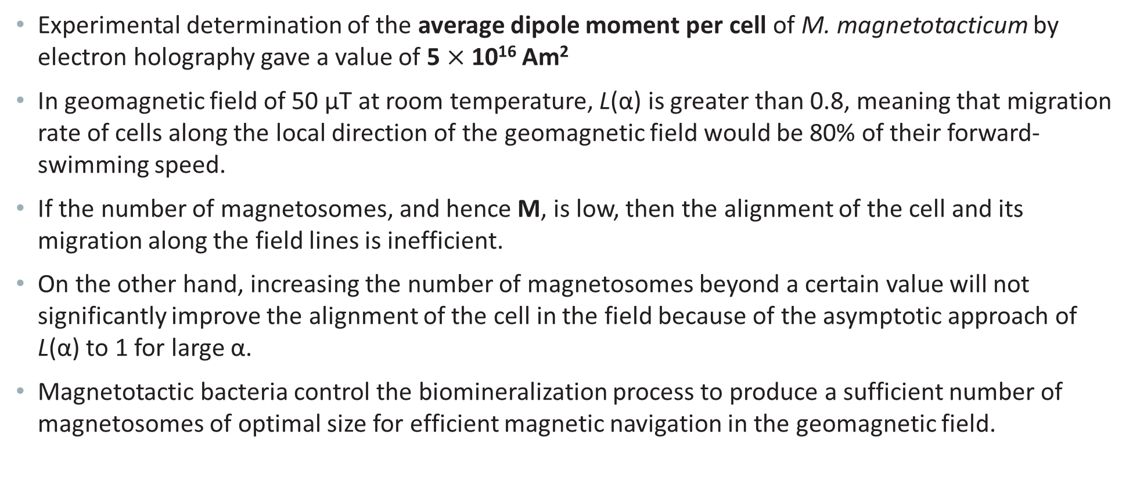
Cellular Magnetic Dipole and Magnetotaxis
Experimental determination of the average dipole moment per cell of M. magnetotacticum by electron holography gave a value of 5 $×$ 10¹⁶ Am²
In geomagnetic field of 50 µT at room temperature, L(α) is greater than 0.8, meaning that migration rate of cells along the local direction of the geomagnetic field would be 80% of their forward-swimming speed.
If the number of magnetosomes, and hence M, is low, then the alignment of the cell and its migration along the field lines is inefficient.
On the other hand, increasing the number of magnetosomes beyond a certain value will not significantly improve the alignment of the cell in the field because of the asymptotic approach of L(α) to 1 for large α.
Magnetotactic bacteria control the biomineralization process to produce a sufficient number of magnetosomes of optimal size for efficient magnetic navigation in the geomagnetic field.

